Slide 1
Discussion 13: More Sorting
Christine Zhou

Slide 2
Agenda
Announcements
(Probably only 2 of these)
Quicksort Review
Problem 1
Stability Review
Problem 2
Radix Sorts
Problem 3

Slide 3
Announcements
Practice Mock Final: Tuesday 5/7 in Dwinelle 155, from 7-10PM
Project 3 Phase 1 is due Friday at 11:59pm!
Office hours
Remember the policies
Only 1 more discussion section!!
Discussion survey: tinyurl.com/cz-disc13-sp19

Slide 4
Quicksort
Algorithm: Pick a pivot, partition elements based on the pivot, repeat on partitions as long as they include more than one element, then combine partitions
How to pick a pivot?
Always pick the leftmost/rightmost element
Randomly pick an element
How to partition?
Three way merge: split into the less than, equal, and greater than partition (auxiliary arrays)
Hoare: split into less than or equal to and greater than partition (in place)
Runtime: (which part of the algorithm most heavily influences the runtime?)
Pivot choice!
Best case: Theta(NlogN)
Worst case: Theta(N^2)

Slide 5
1 Quicksort
Sort the following unordered list using stable quicksort. Assume that the pivot you use is always the first element and that we use the 3-way merge partitioning process described in lecture and lab last week.
Show the steps taken at each partitioning step.
18, 7, 22, 34, 99, 18, 11, 4

Slide 6
1 Quicksort
-18-, 7, 22, 34, 99, 18, 11, 4 (18 is the pivot)
-7-, 11, 4 | 18, 18 | 22, 34, 99 (7 is the pivot)
4, 7, 11, 18, 18 | -22-, 34, 99 (22 is the pivot)
4, 7, 11, 18, 18, 22 | -34-, 99 (34 is the pivot)
4, 7, 11, 18, 18, 22, 34, 99

Slide 7
1 Quicksort
What is the best and worst case running time of Quicksort with Hoare Partitioning on N elements?
Give an example of a list of 5 numbers that would result in best and worst case running time.
Best: Theta(N log N)
Example: 3 1 2 5 4
Worst: Theta(N^2)
Example: 1 3 3 4 5 (if the first or last element is picked as the pivot)

Slide 8
1 Quicksort
What are two techniques that can be used to reduce the probability of Quicksort taking the worst case running time?
1. Randomly choose pivots.
2. Shuffle the list before running quicksort.

Slide 9
Stability
Stable: Two objects with equal keys appear in the same order in sorted output as they appear in the input array
Why do we need stability?
Good for if we’re sorting by multiple keys
Let’s say we’re asked to sort by “by last name, then by first"
We should sort by the first names first, and then sort by the last names
Jennifer Zeng
Katherine Zhou
Chloe Chan
Christine Zhou
Chloe Chan
Christine Zhou
Jennifer Zeng
Katherine Zhou
Chloe Chan
Jennifer Zeng
Christine Zhou
Katherine Zhou

Slide 10
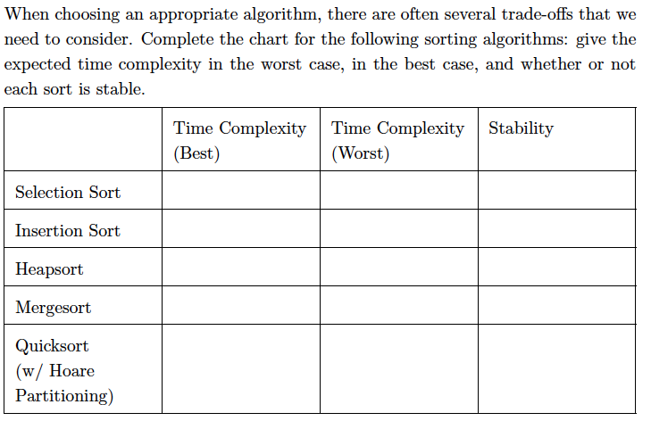
2.1

Slide 11
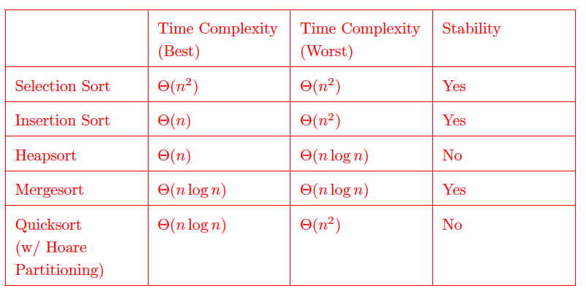
2.1

Slide 12
2.1

Slide 13

2.1

Slide 14
2.1

Slide 15
2.1

Slide 16
2.1

Slide 17
2.1

Slide 18
2.1

Slide 19
2.1

Slide 20
2.1

Slide 21
2.1

Slide 22
2.1

Slide 23
2.1

Slide 24
2.1

Slide 25
2.1

Slide 26
2.2
For each unstable sort, give an example of a list where the order of equivalent items is not preserved.

Slide 27
2.2
Selection sort: 3a, 3b, 3c, 1
Heapsort: 1a, 1b, 1c
Quicksort: 1, 5a, 2, 5b, 3
Note that if using quicksort that randomizes the array, any array could yield instability.

Slide 28
2.3
In general, what are some other tradeoffs we might want to consider when designing or choosing an algorithm?

Slide 29
2.3
Space complexity: The space complexity of an algorithm is the "extra" memory usage of an algorithm with respect to the length of the input.
Consider the space complexity of Mergesort in-place and out-of place.
For merge sort, we use an auxiliary array to do the merging, and that takes ϴ(n) memory. There is an in-place variant, but it is a terrible mess. When merge sorting linked lists, merge sort is still O(n) space, since we create O(n) single item queues.
Constant factors in runtime: especially when working with small inputs.
Readability when other engineers are using your algorithm.

Slide 30
2.4
Notice that the worst-case runtime in the comparison sorts on an N element array listed above are lower bounded by ϴ(N logN). Can there be a sort that has a worst-case faster than ϴ(N logN)?

Slide 31
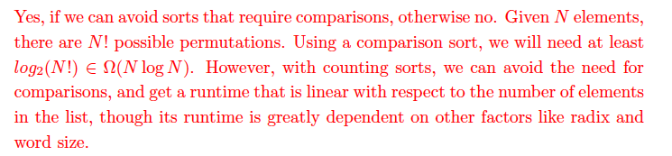
2.4

Slide 32
Counting Sorts
Sort by counting elements

Slide 33
Counting Sorts Demo
↓
Step 1: Count how many of each key there are.
input array to be sorted
4
2
0
1
3
0
1
0
0
1
2
3
4
0
1
2
3
4
counts
0
0
0
0
0
starts
0
0
0
0
0
0
1
2
3
4
5
6
7
sorted output array
0
0
0
0
0
0
0
0
Notes:
example from https://docs.google.com/presentation/d/1qzoz8ekp6EB0KsY5hgRPHXWyPjB4PYtiKFP2p--WPsg/edit#slide=id.g160ba73851_0_5

Slide 34
Counting Sorts Demo
↓
Step 1: Count how many of each key there are.
input array to be sorted
4
2
0
1
3
0
1
0
0
1
2
3
4
0
1
2
3
4
counts
0
0
0
0
1
starts
0
0
0
0
0
0
1
2
3
4
5
6
7
sorted output array
0
0
0
0
0
0
0
0

Slide 35
Counting Sorts Demo
↓
Step 1: Count how many of each key there are.
input array to be sorted
4
2
0
1
3
0
1
0
0
1
2
3
4
0
1
2
3
4
counts
0
0
1
0
1
starts
0
0
0
0
0
0
1
2
3
4
5
6
7
sorted output array
0
0
0
0
0
0
0
0

Slide 36
Counting Sorts Demo
↓
Step 1: Count how many of each key there are.
input array to be sorted
4
2
0
1
3
0
1
0
0
1
2
3
4
0
1
2
3
4
counts
1
0
1
0
1
starts
0
0
0
0
0
0
1
2
3
4
5
6
7
sorted output array
0
0
0
0
0
0
0
0

Slide 37
Counting Sorts Demo
↓
Step 1: Count how many of each key there are.
input array to be sorted
4
2
0
1
3
0
1
0
0
1
2
3
4
0
1
2
3
4
counts
1
1
1
0
1
starts
0
0
0
0
0
0
1
2
3
4
5
6
7
sorted output array
0
0
0
0
0
0
0
0

Slide 38
Counting Sorts Demo
↓
Step 1: Count how many of each key there are.
input array to be sorted
4
2
0
1
3
0
1
0
0
1
2
3
4
0
1
2
3
4
counts
1
1
1
1
1
starts
0
0
0
0
0
0
1
2
3
4
5
6
7
sorted output array
0
0
0
0
0
0
0
0

Slide 39
Counting Sorts Demo
↓
Step 1: Count how many of each key there are.
input array to be sorted
4
2
0
1
3
0
1
0
0
1
2
3
4
0
1
2
3
4
counts
2
1
1
1
1
starts
0
0
0
0
0
0
1
2
3
4
5
6
7
sorted output array
0
0
0
0
0
0
0
0

Slide 40
Counting Sorts Demo
↓
Step 1: Count how many of each key there are.
input array to be sorted
4
2
0
1
3
0
1
0
0
1
2
3
4
0
1
2
3
4
counts
2
2
1
1
1
starts
0
0
0
0
0
0
1
2
3
4
5
6
7
sorted output array
0
0
0
0
0
0
0
0

Slide 41
Counting Sorts Demo
Step 2: Determine starting indices per key.
input array to be sorted
4
2
0
1
3
0
1
0
0
1
2
3
4
0
1
2
3
4
✓ counts
3
2
1
1
1
starts
0
0
0
0
0
↑
0
1
2
3
4
5
6
7
sorted output array
0
0
0
0
0
0
0
0

Slide 42
Counting Sorts Demo
Step 2: Determine starting indices per key.
input array to be sorted
4
2
0
1
3
0
1
0
0
1
2
3
4
0
1
2
3
4
✓ counts
3
2
1
1
1
starts
0
3
0
0
0
↑
0
1
2
3
4
5
6
7
sorted output array
0
0
0
0
0
0
0
0

Slide 43
Counting Sorts Demo
Step 2: Determine starting indices per key.
input array to be sorted
4
2
0
1
3
0
1
0
0
1
2
3
4
0
1
2
3
4
✓ counts
3
2
1
1
1
starts
0
3
5
0
0
↑
0
1
2
3
4
5
6
7
sorted output array
0
0
0
0
0
0
0
0

Slide 44
Counting Sorts Demo
Step 2: Determine starting indices per key.
input array to be sorted
4
2
0
1
3
0
1
0
0
1
2
3
4
0
1
2
3
4
✓ counts
3
2
1
1
1
starts
0
3
5
6
0
↑
0
1
2
3
4
5
6
7
sorted output array
0
0
0
0
0
0
0
0

Slide 45
Counting Sorts Demo
Step 2: Determine starting indices per key.
input array to be sorted
4
2
0
1
3
0
1
0
0
1
2
3
4
0
1
2
3
4
✓ counts
3
2
1
1
1
✓ starts
0
3
5
6
7
0
1
2
3
4
5
6
7
sorted output array
0
0
0
0
0
0
0
0

Slide 46
Counting Sorts Demo
↓
Step 3: Place items in output array.
input array to be sorted
4
2
0
1
3
0
1
0
0
1
2
3
4
0
1
2
3
4
✓ counts
3
2
1
1
1
✓ starts
0
3
5
6
7
↑
0
1
2
3
4
5
6
7
sorted output array
0
0
0
0
0
0
0
0

Slide 47
Counting Sorts Demo
↓
Step 3: Place items in output array.
input array to be sorted
4
2
0
1
3
0
1
0
0
1
2
3
4
0
1
2
3
4
✓ counts
3
2
1
1
1
✓ starts
0
3
5
6
8
↑
0
1
2
3
4
5
6
7
sorted output array
0
0
0
0
0
0
0
4

Slide 48
Counting Sorts Demo
↓
Step 3: Place items in output array.
input array to be sorted
4
2
0
1
3
0
1
0
0
1
2
3
4
0
1
2
3
4
✓ counts
3
2
1
1
1
✓ starts
0
3
6
6
8
↑
0
1
2
3
4
5
6
7
sorted output array
0
0
0
0
0
2
0
4

Slide 49
Counting Sorts Demo
↓
Step 3: Place items in output array.
input array to be sorted
4
2
0
1
3
0
1
0
0
1
2
3
4
0
1
2
3
4
✓ counts
3
2
1
1
1
✓ starts
1
3
6
6
8
↑
0
1
2
3
4
5
6
7
sorted output array
0
0
0
0
0
2
0
4

Slide 50
Counting Sorts Demo
↓
Step 3: Place items in output array.
input array to be sorted
4
2
0
1
3
0
1
0
0
1
2
3
4
0
1
2
3
4
✓ counts
3
2
1
1
1
✓ starts
1
4
6
6
8
↑
0
1
2
3
4
5
6
7
sorted output array
0
0
0
1
0
2
0
4

Slide 51
Counting Sorts Demo
↓
Step 3: Place items in output array.
input array to be sorted
4
2
0
1
3
0
1
0
0
1
2
3
4
0
1
2
3
4
✓ counts
3
2
1
1
1
✓ starts
1
4
6
7
8
↑
0
1
2
3
4
5
6
7
sorted output array
0
0
0
1
0
2
3
4

Slide 52
Counting Sorts Demo
Step 3: Place items in output array.
input array to be sorted
4
2
0
1
3
0
1
0
0
1
2
3
4
0
1
2
3
4
✓ counts
3
2
1
1
1
✓ starts
2
4
6
7
8
↑
0
1
2
3
4
5
6
7
sorted output array
0
0
0
1
0
2
3
4

Slide 53
Counting Sorts Demo
input array to be sorted
4
2
0
1
3
0
1
0
0
1
2
3
4
0
1
2
3
4
✓ counts
3
2
1
1
1
✓ starts
3
5
6
7
8
0
1
2
3
4
5
6
7
✓ sorted output array
0
0
0
1
1
2
3
4
Finished!

Slide 54
Counting Sort Runtime
Keep an array called counts that keeps track of the count of each value, go through the entire array and collect the counts
Keep an array called starts and this will tell us where to start for each element, go through counts and collect the starts
Go through all the elements of the array and place the element where it should belong based on the starts array
Runtime:
N is the number of items in our list, K is the radix
Iterate through the list (N), iterate through the counts (K), iterate through the list again (N)
N + N + K, which is roughly N + K

Slide 55
Radix Sort
LSD Radix Sort
Run counting sort on each digit, starting from the least significant digit (right most)
MSD Radix Sort
Run counting sort on each digit, starting from the most significant digit (left most)

Slide 56
LSD Radix Sort Demo
294
184
161
70
164
162
61
170
Round 1: counting sort on one’s place
0
1
2
3
4
5
6
7
8
9
2
2
1
0
3
0
0
0
0
0
counts

Slide 57
LSD Radix Sort Demo
294
184
161
70
164
162
61
170
Round 1: counting sort on one’s place
0
1
2
3
4
5
6
7
8
9
2
2
1
0
3
0
0
0
0
0
counts
Round 2: counting sort on ten’s place
70
170
161
61
162
294
184
164
0
1
2
3
4
5
6
7
8
9
0
0
0
0
0
0
4
2
1
1
counts

Slide 58
LSD Radix Sort Demo
294
184
161
70
164
162
61
170
Round 1: counting sort on one’s place
0
1
2
3
4
5
6
7
8
9
2
2
1
0
3
0
0
0
0
0
counts
Round 2: counting sort on ten’s place
70
170
161
61
162
294
184
164
0
1
2
3
4
5
6
7
8
9
0
0
0
0
0
0
4
2
1
1
counts
Round 3: counting sort on hundred’s place
161
061
162
164
070
170
184
294
0
1
2
3
4
5
6
7
8
9
2
7
1
0
0
0
0
0
0
0
counts

Slide 59
LSD Radix Sort Demo
294
184
161
70
164
162
61
170
Round 1: counting sort on one’s place
0
1
2
3
4
5
6
7
8
9
2
2
1
0
3
0
0
0
0
0
counts
Round 2: counting sort on ten’s place
70
170
161
61
162
294
184
164
0
1
2
3
4
5
6
7
8
9
0
0
0
0
0
0
4
2
1
1
counts
Round 3: counting sort on hundred’s place
161
061
162
164
070
170
184
294
0
1
2
3
4
5
6
7
8
9
2
7
1
0
0
0
0
0
0
0
counts
Finished!
61
70
161
162
164
170
184
294

Slide 60
Radix Sort Runtime
Let D = number of digits, K = the radix (for example, if sorting on base-10 digits, K=10), and N = length of the array.
Runtime of one pass of counting sort is O(N+K)
Runtime of radix sort is O(D(N+K)).
This could be really bad if D is high! Quadratic time or worse.

Slide 61
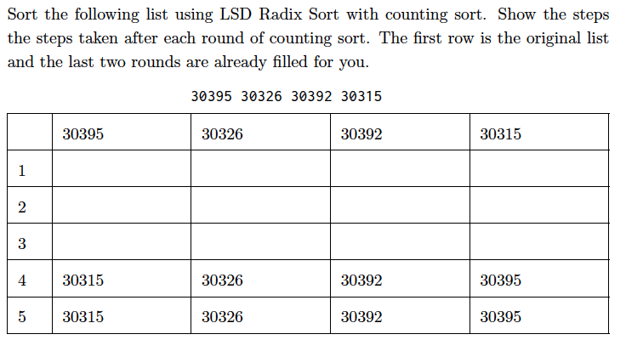
3.1 LSD

Slide 62


3.1 LSD

Slide 63




3.1 LSD

Slide 64



3.1 LSD

Slide 65
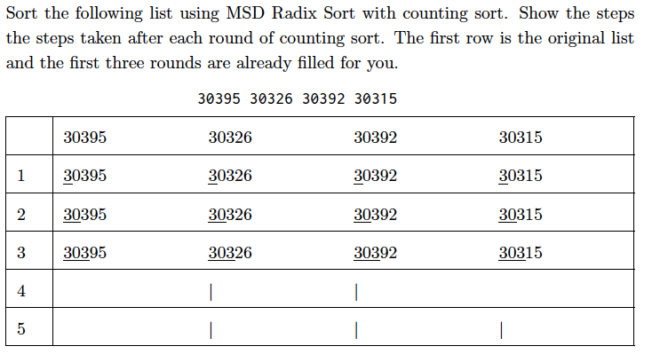
3.2 MSD

Slide 66
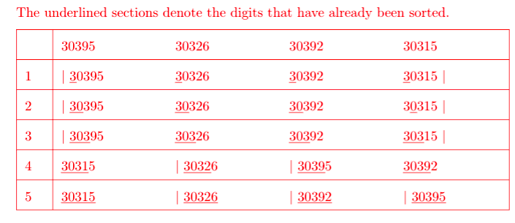
3.2 MSD

Slide 67
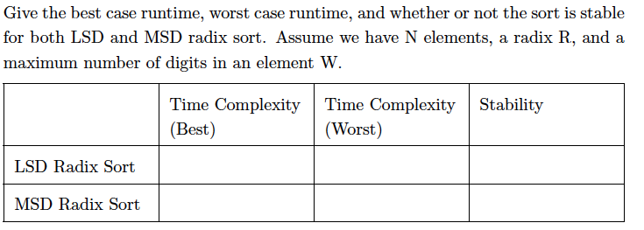
3.3

Slide 68
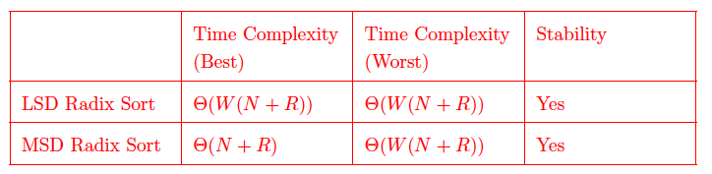
3.3

Slide 69
3.3

Slide 70
3.3

Slide 71
3.3

Slide 72
3.3

Slide 73
3.3

Slide 74
3.4
Is radix sort always the best sort to use? Explain why or why not.
No.
Though radix sort runs linear with respect to the number of elements in the list, the runtime also depends on the size of the radix R and the length of the longest ”word” W (or the number of digits in a number). Additionally, it is not always possible to use radix sort, because not all objects can be split up into digits. However, comparison sorts can be used on any object that defines a compareTo method, and would work well with compareTo methods that are fast.

Slide 75
4.1

Slide 76
4.2

Slide 77
4.3

Slide 78
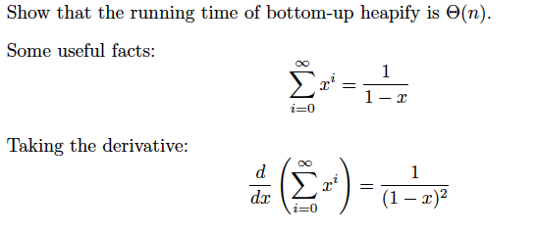
4.4

Slide 79
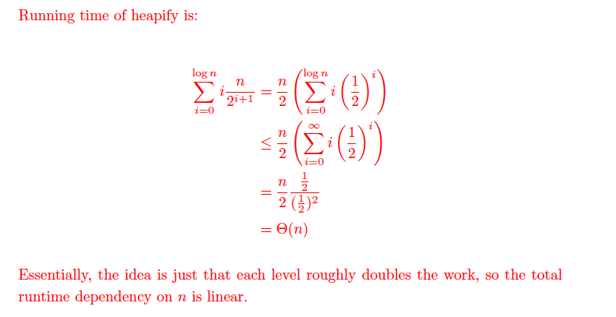
4.4

